Slide 1
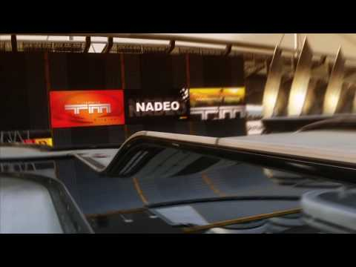
TMCHALLENGER
By:
Kamal Nimmagadda
Mehul Kohli
Ritika Singhal
Rohan Marathe

Slide 2
Data Collection
Collected screengrabs of gameplay: images with and without obstacles, cropped images of the speed and timestamps of game play
Applied digit recognition to extract speed and timestamps as text from the screengrabs

Slide 3
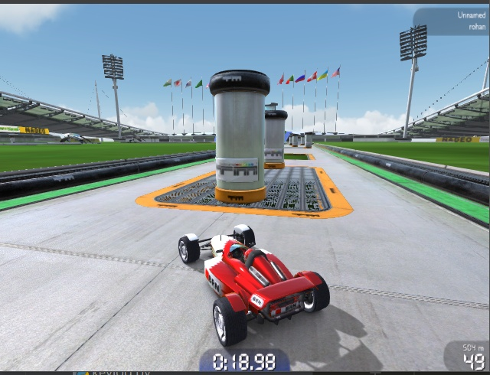
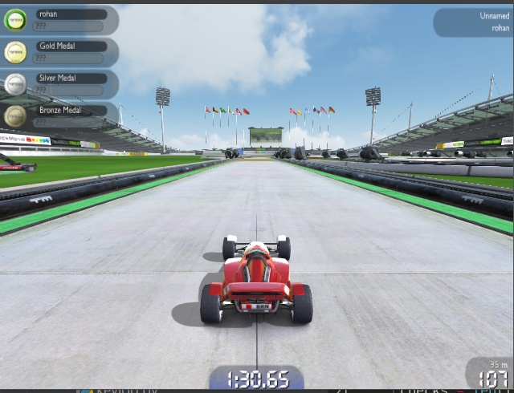
Images Preview
Images with and without objects grabbed from the gameplay.
Speedometer’s images sliced from the screengrabs of the gameplay, and digits are sliced from those images. Each digit has a dimension of 25x12.

Slide 4

Open AI Gym (Box 2D)

Slide 5
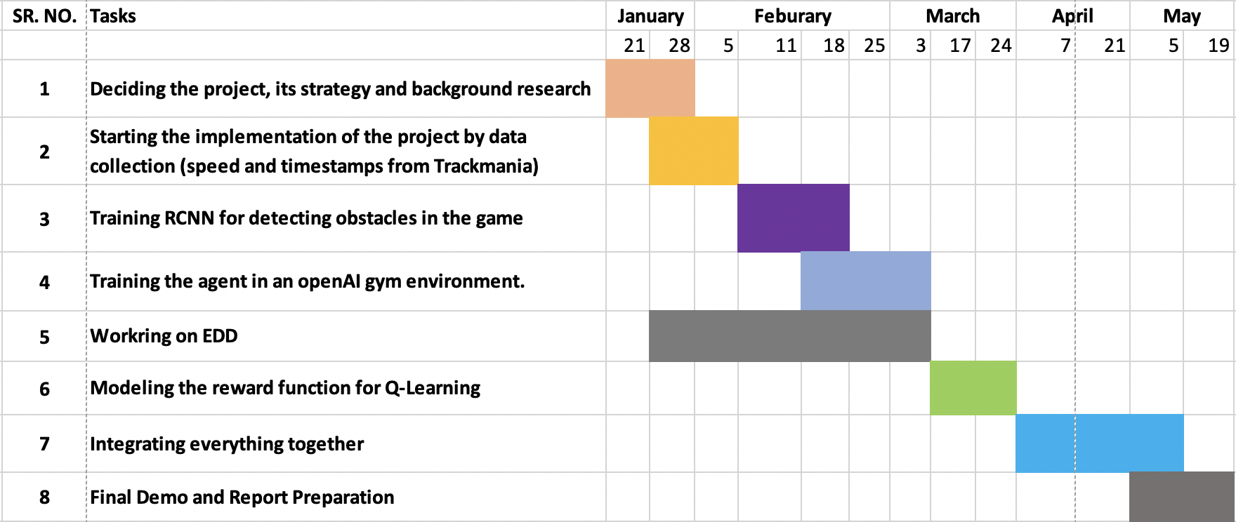
Project Schedule

